Slide 1

DriverPass System Analysis
Jared Flynn
Notes:
[No speaker notes required for this slide.]

Slide 2

System Requirements
Functional Reuirements
The system shall prompt customer with three package options.
The system shall allow the admin to disable/remove packages when they are full or no longer available.
Non-functional Requirements
Users shall have a case sensitive username and a unique password validated by the system when logging in
The system shall be a web-based application
Notes:
[In your speaker notes, include an explanation of the different requirements you determined for DriverPass’s system. What are the functional requirements you selected to describe? What are the nonfunctional requirements you selected to describe? Be sure to explain how these requirements meet DriverPass’s needs.]

Slide 3
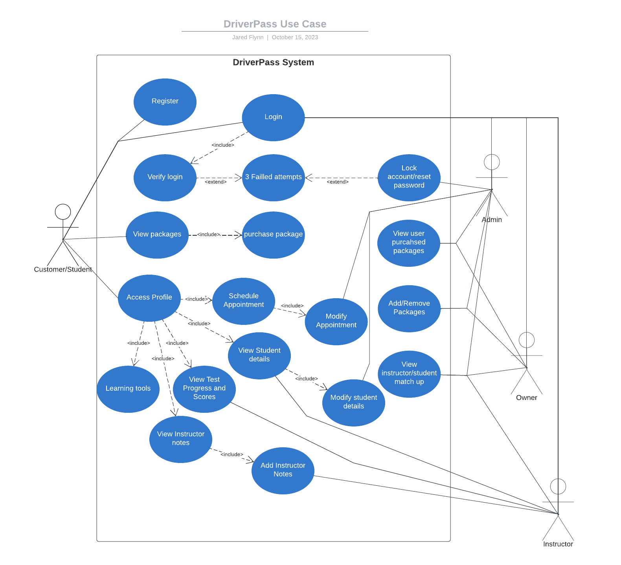
Use Case Diagram
Notes:
[Explain your diagram. Who are the different actors in the system? What are the different use cases? How did you account for DriverPass’s needs in your design? In your explanation, keep your audience in mind. Avoid the use of terms like “actors” and “use cases” in your explanation.]

Slide 4
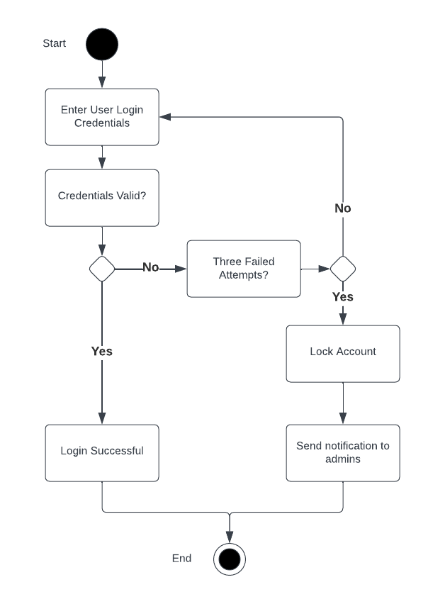
Activity Diagram
Notes:
[Explain your diagram. Which use case are you breaking down? What are the steps for this use case? How did you account for DriverPass’s needs in your design? In your explanation, keep your audience in mind. Avoid the use of technical terms such as “nodes,” “control flows,” and so on.]

Slide 5
Security
Users will have unique username and passwords
The system will be hosted on a cloud server
Industry standard encryption will be utilized for information stored in database
Multiple failed login attempts will lock out a user account preventing brute force attacks
Administrators will have access to account management to modify/remove accounts presenting a security threat
Notes:
[How did you consider security in your design? In your explanation, keep your audience in mind by avoiding the use of technical terms.]

Slide 6
System Limitations
Limited package availability
Limited resources to accommodate packages (instructors, vehicles, etc…)
Third Party handling of financial transactions
Users are auto paired with a random instructor and cannot choose who they want
Narrow timeline to complete project
Notes:
[What are the limitations of your design? In your explanation, keep your audience in mind by avoiding the use of technical terms.]

